Slide 1

WELCOME TO CFG
YOUR INTRODUCTION TO
DATABASES & SQL PROGRAMMING LANGUAGE
TECH OPENS UP LIMITLESS OPPORTUNITIES FOR GIRLS
Notes:
1] Welcome students onto the course and introduce CFG! Our mission, why we do what we do and encourage them to share their experience on the course with others.

Slide 2
WHAT IS BIG DATA?
Notes:
Ask students to answer this question in their own words ☺ “first thing that comes to their mind when they think of BIG DATA”
It would be interesting to gauge “where is the group” in terms of their understanding of the BIG DATA concept

Slide 3


INFOMRATION
Big Data
HUGE VOLUME
Structured and Unstructured
Notes:
SLIDE CONTAINS ANNIMATION:
Explain that Everything that we do: online activities, e-commerce, work, social media, phone calls, messaging…all these form BIG DATA
Data is an incredibly valuable source to analyse trends, patterns dependencies, data gives you the power of knowledge!
It is an invaluable source of information.
Data is everywhere!
Definition -- Big Data? In it’s purest form, Big Data is used to describe the massive volume of both structured and unstructured data that is so large it is difficult to process using traditional techniques. So Big Data is just what it sounds like — a whole lot of data.

Slide 4

CAPTURED
Data Collection
STORED
Data Persisted
ANALYSED
Data study

Slide 5


DATABASE
Data storage
SQL PROGRAMMING
Data access and processing
Notes:
Explain that data is stored in a DB
SQL is a programming language that allows us to access and process i.e. query our data

Slide 6
HOW IS DATA USED IN TECH?
MOST COMMON APPLICATION FIELDS
Notes:
Ask students to answer this question in their own words ☺ It would be interesting to see what they think

Slide 7

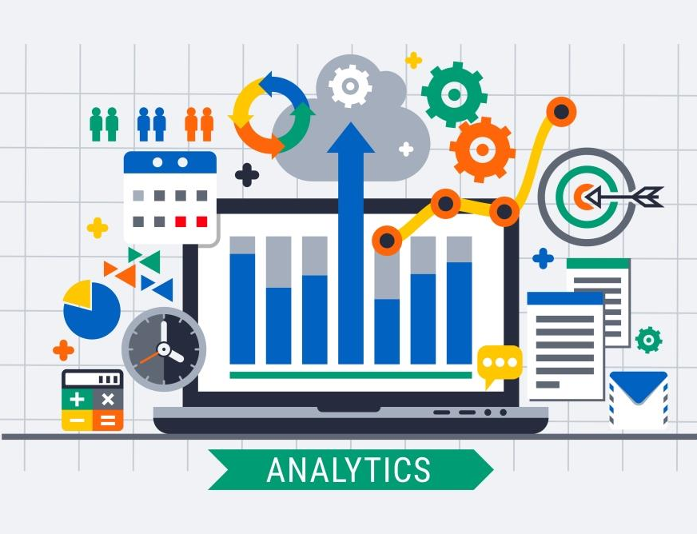
SOFTWARE ENGINEERING
Programming and Development
DATA ANALYSIS
Data Science and Data Processing
Notes:
SLIDE CONTAINS ANNIMATION:

Slide 8

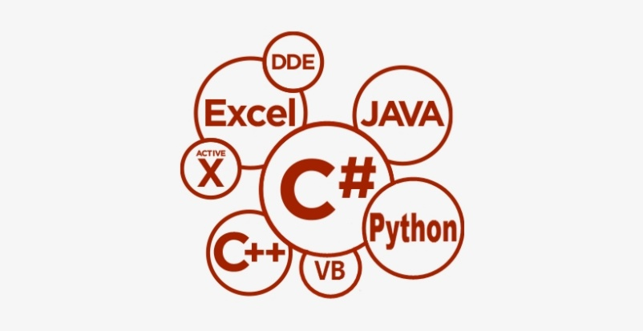

SOFTWARE ENGINEERING
Programming and Development
FRONTEND
BACKEND
DATABASE
LAYERS
MODEL
Notes:
Explain how DB and DATA fit into software engineering cycle. Some general comments below.
FRONTEND
Websites and mobile applications.
We create interfaces with html, css JavaScript, Rectangular, Angular frameworks etc.
Main purpose it to communicate with the user: take input and display output, provide information
BACKEND
Logic behind the scenes. We can take uses input from the frontend and process it.
All calculations, processes, manipulation, all actions are happening here.
We also create services to send data to frontend and DB. We send data to DB and retrieve it from here!
DB
We persist all data and information in the DB.
We can write SQL queries, aka code, directly in the DB management system or in the logic layer.
DB is a separate layer. Pretty much everything requires memory and data storage.

Slide 9
DATA ANALYSIS
Data Science and Data Processing
#1
Data Science
Frame the problem to solve
Collect and store raw data
Process the data
Explore the data
In-depth analysis
Communicate and visualise results
#6
#2
DATA SCIENCE STEPS
#5
#3
#4
Notes:
Ask a lot of questions → translate an ambiguous request into a concrete, well-defined problem
Identify all available data sets, extract and persist data. / SQL and DB will be used at this stage as well
Examine data at high level, clean the data , identify missing values, understand what kind of data each column contains / SQL and DB will be used at this stage as well
Identify any dependencies or patterns within a data set, plot data in different ways / SQL and DB will be used at this stage as well
Create a predicative model, evaluate the data model
Visualise your findings , tell a clear and actionable story.

Slide 10
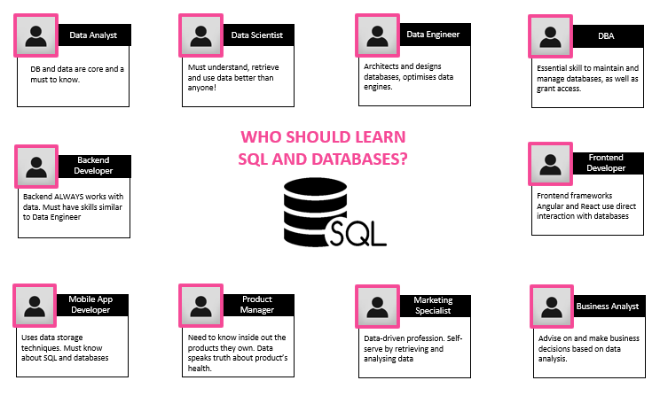

WHO SHOULD LEARN SQL AND DATABASES
Which jobs require or would benefit from these skills?
HOMEWORK TASK 1
Review this slide in your ‘Reference Materials’ section.
Identify the occupation that is closest to ‘where you would like to be’ (you can research more jobs online)
Write down a paragraph outlining what your desired job or role would be and how would you like you use your Data, SQL and DB skills.

Slide 11





COURSE JOURNEY
Database design and data visualisation
Project presentations and mock interviews
MODULE 7
MODULE 8
Data management using SQL coding techniques
MODULE 6
Data manipulation with SQL programming language
Data analysis for complex structures
MODULE 5
MODULE 4
Data analysis
MODULE 3
Introduction to SQL programming language and Data Science
SQL coding and Database management technique
Introduction to SQL programming language and Data Science
MODULE 1
MODULE 2
MODULE 1

Slide 12
MODULE 1: HTML
INTRO TO SQL AND
DATA SCIENCE
Understand what is SQL and Databases (DB) and how to use them.
Learn about different types of data.
Create our first Database and Tables.
Learn core commands to insert and get data from a DB
01

Slide 13
WHAT IS A DATABASE?
Notes:
Ask students to answer this question in their own words ☺ It would be interesting to see what they think

Slide 14



SQL
SQL code to query the database to extract required data
Data sets combined within DB as per query to extract required data
Data extracted or can be analysed even further if required
Notes:
DB - Container that holds data, data is held in tables (each table has columns and rows, similar to a spreadsheet). One database holds many tables
TABLES - DB can contain hundreds of tables and all those tables can be related to one another. DB can hold data for the whole line of business, e.g. HR, Finance, Sales. We can easily retrieve data from a DB, including data from multiple tables combined at the same time. We can also update and insert data more efficiently.
SQL - Structured Query Language (SQL) is a special-purpose programming language. SQL is used to communicate with a database. It manipulates and manages sets of data. SQL code is used to perform tasks on the datasets in a database

Slide 15
RDBM - a way to describe how we are going to store the data in the DB and how those individual pieces of data are going to contain relationships to each other
In a relational database, we store data inside of something called a table
Tables in a DB are related to one another. If we look at the DB diagram, we can see those relations depicted with lines/arrows
From the diagram we can also see all table names, their columns and data types stored in each column
NB: read more about RDBM https://www.codecademy.com/articles/what-is-rdbms-sql
RELATIONAL DATABASE MODEL
(RDBM)

Slide 16
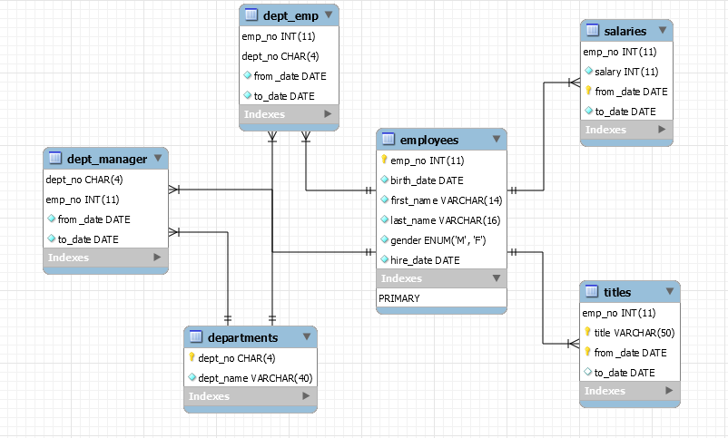
EXAMPLE – EER DIAGRAM
Let’s review a Relational Database Diagram for a DB called “Company”.
TABLE Employees
It has 6 columns and it is related to other tables
TABLE dept_emp
It is a JUNCTION table: because it has id combinations of employees and departments, i.e. which employee belongs to which department. It cannot exist without tables employee or departments.
TABLE Salaries
It is related to the table employees, because each employee has a band (salary ID) and salary (amount) .

Slide 17
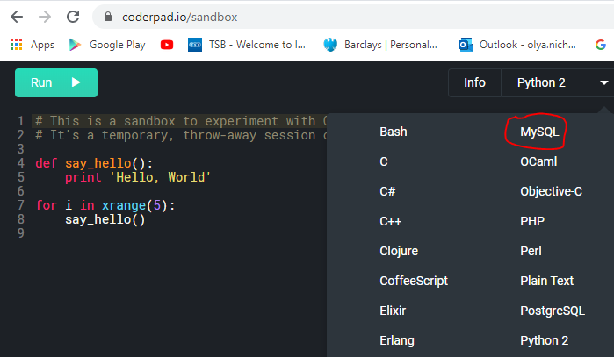

PRACTICE
LET’SEE HOW IT WORKS IN PRACTICE
https://coderpad.io/sandbox
Notes:
1. Navidate

Slide 18

One of the most common tasks is to retrieve data from a DB. Let’s imagine that we have a simple table in our DB that contains information about people.
These are our contacts.
Name | Surname | Telephone
Lucy | Smith | 020 7777 8888
Mike | Peters | 020 2222 3333
Julie | Andrews | 074 7878 1212
ASK DB A QUESTION
How many of my contacts have a surname starting with ‘P’?
Asking DB questions is called ‘QUERYING’.
Each query is a piece of code that we write in SQL language.

Slide 19
When we create a DB and tables within that database, we need to specify each column type, i.e. what kind of data will this column hold
We also need to specify any constrains or restrictions that a column might have. It might be type of data, size of data, format of data or disclaimer where it is required or not
Compare the two tables below: the latter does not have a value in the telephone column, but has something else
TABLES
COLUMNS
NAMES
Example 1
Name | Surname | Telephone
Lucy | Smith | 020 7777 8888
Mike | Peters | 020 2222 3333
Example 2
Name | Surname | Telephone
Lucy | Smith | null
Mike | Peters | 020 2222 3333

Slide 20
We will be using these data types to create tables and specify what kind of values each column should hold
DATA TYPE | VALUE SPACE
CHAR(size) | Fixed-length strings, where size is the number of characters to store. (max 255 characters)
VARCHAR(size) | Variable-length strings, where size is the number of characters to store. (max 255 characters)
BINARY | Fixed-length strings, where size is the number of binary characters to store. (max 255 characters)
FLOAT(p) | Floating point number, where p is a precision
INTEGER | Standard integer value, allows whole numbers
DECIMAL(m,d) | Fixed point number, where m is the total digits and d is the number of digits after the decimal.
BOOLEAN | Data type where a value of 0 is considered to be FALSE and any other value is considered to be TRUE
DATE | Displayed as 'YYYY-MM-DD'.
TIME | Displayed as 'HH:MM:SS'.
TIMESTAMP | Displayed as 'YYYY-MM-DD HH:MM:SS'.
SQL
DATA TYPES
(CORE)
NB: read more about data types:
https://www.w3schools.com/sql/sql_datatypes.asp

Slide 21
NULL is a special value in SQL, it indicates a lack of a value!
NULL value is different from a zero value or a field that contains spaces: NULL value is one that has been left blank during record creation ( it means data does not exist in the database)
Columns can be required or not required: required is NOT NUL and not required is NULL
NULL VALUES
NULL | NOT NULL
Default for a column definition | Must be specified on column definitions
It means that we are allowed to insert NULL values | It means we are not allowed to insert NULL values. Inserting a NULL would raise an error!

Slide 22
SQL SYNTAX
CODING QUERIES
Notes:
Ask students to answer this question in their own words ☺ It would be interesting to see what they think

Slide 23
identifier
identifier
SELECT column_name FROM table_name ;
keyword
keyword
always end a query with semi-colon

Slide 24
Think of a SELECT statement as a question that we ask the database
EXAMPLE QUESTIONS
What are all the fruit that we have in stock?
How many contacts do we have in out phone book?
Who are all my contacts with surname ‘Smith’?
How many flights to New York do we have on Tuesday?
What is the party with the highest number of voter region?
SELECT

Slide 25
Quite often SELECT statement contains a list of columns that follow this key word
The names of these columns come from a table that we are using for this query (‘our question’)
We add a coma after each column name, except for the last column
Then we need to include a FROM statement to specify the table that is required for this query
SELECT
(LIST)

Slide 26
SYNTAX
EXAMPLE
SELECT
<column_name>, <column_name>
FROM <table_name>;
SELECT
first_name,
last_name
FROM person;
Table Person
first_name | last_name | telephone
Lucy | Smith | 020 7777 8888
Mike | Peters | 020 2222 3333
Julie | Andrews | 074 7878 1212

Slide 27
SYNTAX
EXAMPLE
The * character is a wildcard that gets ALL columns from a table. It also may be called ‘select list’ of all columns
SELECT *
FROM person;
SELECT *
FROM <table_name>;
BAD PRACTICE ☹

Slide 28
FROM clause specifies the table that we want to query, i.e. the table that we want to use when asking a database a question.
PLEASE NOTE
SQL syntax also allows us to qualify a column name with a table name – it is very useful when we write complex queries that involve multiple tables.
We can also alias a table name with any word or abbreviation – it helps us to avoid wordy statements and make our syntax neater.
FROM

Slide 29
SYNTAX
EXAMPLE
Column names are qualified with the table name
SELECT
<table_name>.<column_name>,
<table_name>.<column_name>,
FROM <table_name>;
SELECT
person.first_name,
person.last_name
FROM person;
GOOD PRACTICE ☺

Slide 30
SYNTAX
EXAMPLE
Table name alias
SELECT
p.first_name,
p.last_name
FROM person p;
SELECT
<alias>.<column_name>,
<alias>.<column_name>,
FROM <table_name> <alias>;
BEST PRACTICE ☺

Slide 31
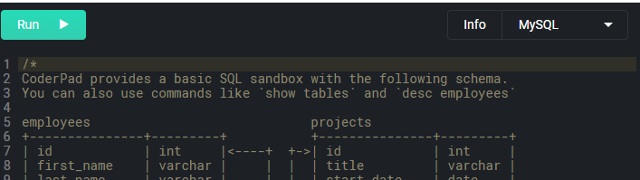
PRACTICE
LET’S WRITE OUR FIRST QUERIES TOGETHER
https://coderpad.io/sandbox
WRITE THE FOLLOWING QUERIES
Go to the sandbox MySQL and write a query to show me all project names and their budgets.
Show me all information from the employees table
Let’s write our very first queries together!
Notes:
1. Navidate

Slide 32
SQL SYNTAX
BUILDING A DATABASE
Notes:
Ask students to answer this question in their own words ☺ It would be interesting to see what they think

Slide 33
Oddly this statement not part of the SQL Standard
It is supported by most implementations
USE DATABASE command to scope future queries
We can also fully qualify table name to database
CREATE
DATABASE

Slide 34
SYNTAX
EXAMPLE
CREATE DATABASE Food;
USE DATABASE Food;
SELECT *
FROM Fruit;
SELECT *
FROM Food.Fruit
Example 1
CREATE DATABASE <DB_name>;
Example 2
USE DATABASE <DB_name>;
SELECT *
FROM <table_name>;
Example 3
SELECT *
FROM <DB_name>.<table_name>;
CREATE DB COMMAND
USE DB COMMAND
ALL QUERIES WILL BE IN THIS DB
FULLY QUALIFIED TABLE NAME

Slide 35
Is part of SQL Standard
Followed by table name
Then list of column definitions
At minimum column name and type
CREATE
TABLE

Slide 36
SYNTAX
EXAMPLE
CREATE TABLE <table_name>
(col1 Type,
col2 Type,
col3 Type);
CREATE TABLE customers
(person_id INTEGER,
name VARCHAR(50),
surname VARCHAR(50),
telephone INTEGER);
CREATE TABLE + TABLE NAME
COLUMN NAMES AND TYPES

Slide 37
SYNTAX
EXAMPLE
CREATE TABLE <table_name>
(col1 Type,
col2 Type,
col3 Type);
CREATE TABLE customers
(person_id INTEGER NOT NULL,
name VARCHAR(50),
surname VARCHAR(50) NOT NULL,
telephone INTEGER);
NOT NULL (these values are required)
NULL (this value can be omitted)
NOT NULL (must have)

Slide 38
PRACTICE
It is time to create our very first database and populate it with few tables.
TASKS
Create a database called Bakery.
Let’s add two tables to the database. One should be called ‘Sweet’ and the one should be called ‘Savoury’
The Sweet table should have three columns: id (which is a number), item_name (name of a pastry) and price (prices can be expressed in pound and pennies)
Include the same columns in the Savoury table. In addition to that add a column called main_ingredient (it will be a descriptive word)
Let’s do it together!
Notes:
1. Navidate

Slide 39
We now know how to create tables, but we also need to be able to populate them with data
The actual command syntax is INSERT INTO, meaning that we are inserting values into a table
The command is followed by a table name (only one table is allowed
Statement is used to add new rows of data to a table
INSERT

Slide 40
SYNTAX
EXAMPLE
INSERT INTO table_name
(col1, col2, col3)
VALUES
(val1, val2, val3);
INSERT INTO
customers
(name, surname, telephone)
VALUES
(‘Mary’, ‘Jones’, 123-4567)
INSERT INTO
TABLE
COLUMN NAMES
VALUES KEYWORD
VALUES

Slide 41
INSERT allows only one table and column list
Insert multiple rows with one statement
Inserting multiple rows can be achieved by inserting multiple value lists
Alternatively we can use SELECT statement following table name to perform bulk insert
BULK INSERT

Slide 42
SYNTAX
EXAMPLE
INSERT INTO table_name
(col1, col2, col3)
VALUES
(val1, val2, val3),
(val4, val5, val6),
(val7, val8, val9);
INSERT INTO
customers
(name, surname, telephone)
VALUES
(‘Mary’, ‘Jones’, 123-4567),
(‘Julie’, ‘Smith’, 123-0000)
(‘Joanna’, ‘Bates’, 777-8888);
INSERT INTO
TABLE
COLUMN NAMES
VALUES KEYWORD
MULTIPLE VALUS LIST (COMA SEPARATED)

Slide 43
SYNTAX
EXAMPLE
We can use a select statement to retrieve data from one table and paste it into another as long as their schemas match.
INSERT INTO table_name
(col1, col2, col3)
SELECT *
FROM old_table_name
WHERE
old_table_name.col > 10;
INSERT INTO
customers
SELECT *
FROM old_customers
WHERE
old_customers.cust_id > 10;
INSERT INTO
TABLE
SELECT STATEMENT

Slide 44
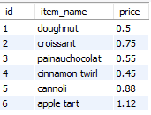

PRACTICE
We need to populate tables that we created in the Bakery database. At the moment they are like empty shells. Let’s add some data to get the result below.
TASKS
Make Sweet table look like this
Make Savoury table look like this
Notes:
1. Navidate

Slide 45

HOMEWORK
Complete task No1 → review roles that require SQL and DB skills to complete a paragraph about your goals and ideal role vision.
Revise the slides and practice to write SELECT queries using default databases or the database that we created in class
Read about RDBM: https://www.codecademy.com/articles/what-is-rdbms-sql
Read about Data Types: https://www.w3schools.com/sql/sql_datatypes.asp
Create a new Database called Parts. It must include 4 tables called ‘part’, ‘project’, ‘supplier’ and ‘supply’
Your instructor will share a file with you which will have pictures of four table examples. Please re-create these tables in a new database
VERY IMPORTANT: we will use new DB parts during week 2, it is essential that you create all tables

Slide 46
THANK YOU
HAVE A GREAT WEEK!

Slide 47



REFERENCE
MATERIALS

Slide 48

TECHNICAL SET UP
TECHNICAL SET UP
In this course, we are going to use the standards-based SQL language
We will use a particular database product called MySQL, which is an open-source relational database management system
We also will use MySQL Workbench - a visual database design tool that would help us to perform tasks when working with databases

Slide 49

SQL is one of the most sought-after skills by hiring employers in the tech world!
It is a lucrative skill by itself or in combination with other development or analytical skills
SQL developers and data scientists are in high demand!
You must know how to write SQL queries if you want to be a backend or frontend developer
SQL is a standard language for working with databases (it has been the industry standard for the past 30-40 years!)
You can access and work with more data faster
SQL is easy and it is also the first step towards data science career!
WHY SQL & DATABASES

Slide 50

Data Analyst
Data Scientist
Data Engineer
DBA
DB and data are core and a must to know.
Must understand, retrieve and use data better than anyone!
Architects and designs databases, optimises data engines.
Essential skill to maintain and manage databases, as well as grant access.
WHO SHOULD LEARN
SQL AND DATABASES?
Backend Developer
Frontend Developer
Backend ALWAYS works with data. Must have skills similar to Data Engineer
Frontend frameworks Angular and React use direct interaction with databases
Mobile App Developer
Product Manager
Marketing Specialist
Business Analyst
Uses data storage techniques. Must know about SQL and databases
Need to know inside out the products they own. Data speaks truth about product’s health.
Data-driven profession. Self-serve by retrieving and analysing data
Advise on and make business decisions based on data analysis.

Slide 51
FRONTEND
BACKEND
DATABASE
interface
logic
data
LAYERS MODEL
Websites and mobile applications. We create interfaces with html, css JavaScript, Rectangular, Angular frameworks etc.
Main purpose it to communicate with the user: take input and display output, provide information.
Logic behind the scenes. We can take uses input from the frontend and process it. All calculations, processes, manipulation, all actions are happening here. We also create services to send data to frontend and DB. We send data to DB and retrieve it from here!
We persist all data and information in the DB. We can write SQL queries, aka code, directly in the DB management system or in the logic layer. DB is a separate layer. Pretty much everything requires memory and data storage.

Slide 52
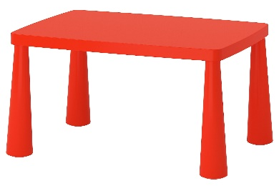
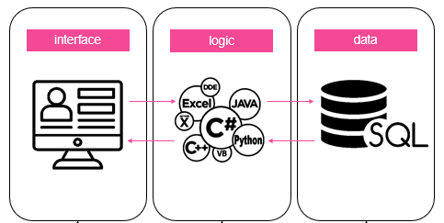
EXAMPLE 1 – LOCAL DB
Let’s order some new furniture, maybe a table from an online shop!
#1
We go to IKEA or any other website and search for a particular red table that we want!
#2
Interface accepts our input and passes it on to the backend to process.
#3
Backend does all processing and forms SQL query for DB.
#4
Backend connects to DB and runs the query i.e. asks if we have that red table in stock.
TA-DA!
We can now buy the table! (NB: our order will be processed and DB will log ‘-1’ table in its stock. `
#5
DB finds the relevant stocks table, checks red table availability and returns results to backend.
#7
Frontend gets data from backend and displays it to us nicely.
#6
Backend processes and evaluates data. It can see that red tables is available it passes the message to frontend.

Slide 53
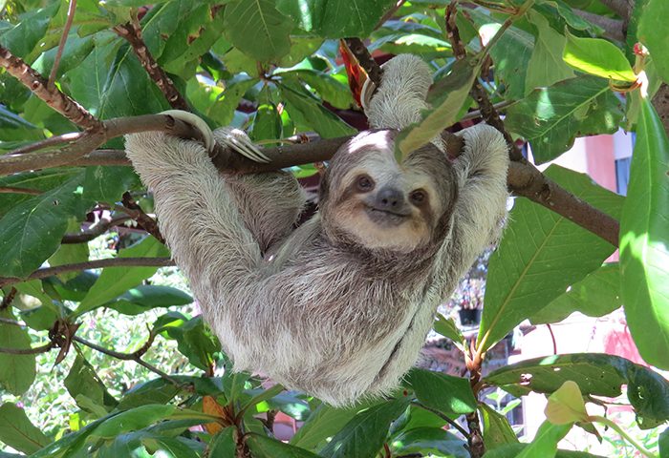
EXAMPLE 1 – REMOTE DB WITH API
Let’s imagine that we are going on holidays and want to book flights to sunny Costa Rica.
#1
We go to KAYAK or Skyscanner website and input our flight search criteria.
#2
Interface accepts our input and passes it on to the backend to process.
#3
Backend does all processing, setup filters and forms a request for API to retrieve data.
#4
A call to API is made to request data about flights from databases.
TA-DA!
We choose a flight to go and see sloths ☺.
#5
API calls database, gets data and returns a bulk of data to backend.
API
#7
Frontend gets data from backend and displays it to us nicely.
#6
Backend processes data, forms it into logical output and passes it back to frontend.

Slide 54

Structured Query Language (SQL) is a special-purpose programming language

Slide 55
SPECIAL
PURPOSE
SQL is used to communicate with a database
It manipulates and manages sets of data
Relational Database contains sets of data
SQL statements (code) are used to perform tasks on the datasets in a database

Slide 56
DATABASE
(SHORT DB)
Container that holds data
Data in the DB container is organised in a particular way
Data is held in tables (each table has columns and rows, similar to a spreadsheet). One database holds many tables
Data can be efficiently stored and retrieved from DB

Slide 57

Commonality: data stored in table as rows and columns
DB can contain hundreds of tables and all those tables can be related to one another
DB can hold data for the whole line of business, e.g. HR, Finance, Sales
We can easily retrieve data from a DB, including data from multiple tables combined at the same time. We can also update and insert data more efficiently
DATABASE
VS
SPREADSHEET

Slide 58
DATA IN
DATABASE
We want to put data in a DB in such way that it makes the one and only source of truth
We want data to be accessible and we want it to be easy to ‘query’, i.e. ask the DB questions about our data
We want to add new data and delete old, unused one, so we want to manage and maintain our data efficiently
We want to persist data and keep it safe

Slide 59

QUICK SUMMARY
Databases are one of the most important parts of the tech world. It is widely used in programming, software development, application development and many other areas
We use SQL language to communicate with Databases, specifically, we ask DB questions to retrieve data
Relational Database holds many tables that have connections to each other, i.e. tables are related to one another in a certain way
Data is stored in tables. Each table has columns, rows, cells and restrictions applied to them
There are many different types of data that can be stored in table columns. There are also NULL values, which mean that ‘in theory data exist, but it is not available in the DB’

